Slide 1

DIWALI SALES ANALYSIS
PIYUSH SHUKLA
Reg:- 12205703
Mail id:- shuklapiyush186@gmail.com 20-7-2024

Slide 2
OUTLINE
Executive Summary
Introduction
Methodology
Results & Visualization
Findings & Implication

Slide 3
EXECUTIVE SUMMARY
Diwali Sales data analysis
Identifying trends and insights across various parameters, including gender, marital status, age group, product category, state, product ID, and occupation.
Understanding which groups and categories are contributing the most to sales, enabling targeted marketing and sales strategies.

Slide 4
INTRODUCTION
About:
Analyzing Diwali sales data to understand sales performance
Objective:
Detailed analysis of Diwali sales data
Identifying key trends and insights based on various parameters

Slide 5
METHODOLOGY
Data collection Sources
https://drive.google.com/file/d/1mGY1doT8RRTgIS0eZsiexHOjUIel9pvo/view?usp=drive_link
Data cleaning
Data exploration
Data visualization
Data analysis and conclusion

Slide 6
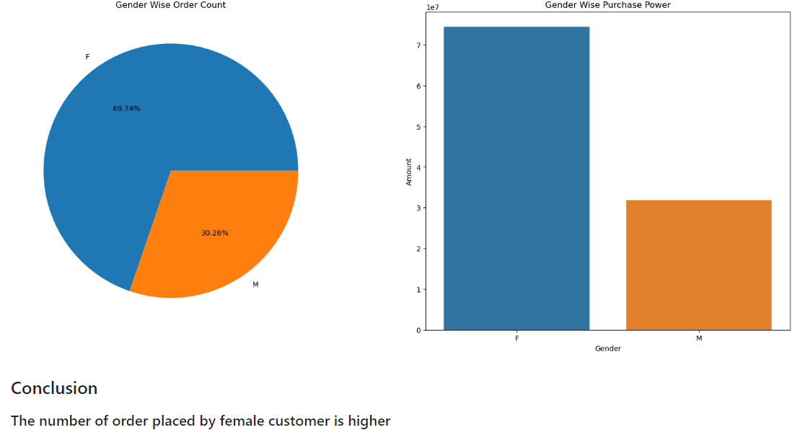
RESULT(WITH VISUALIZATION)
Gender Wise Analysis

Slide 7
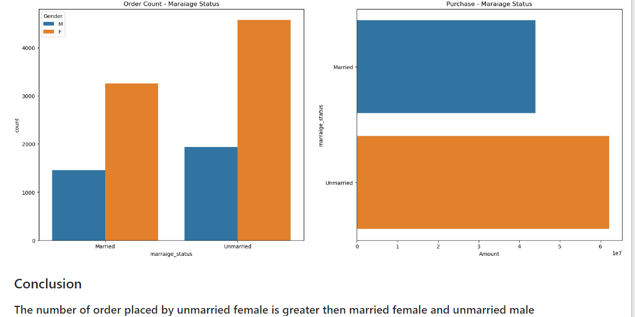
Marital Status Wise Analysis

Slide 8
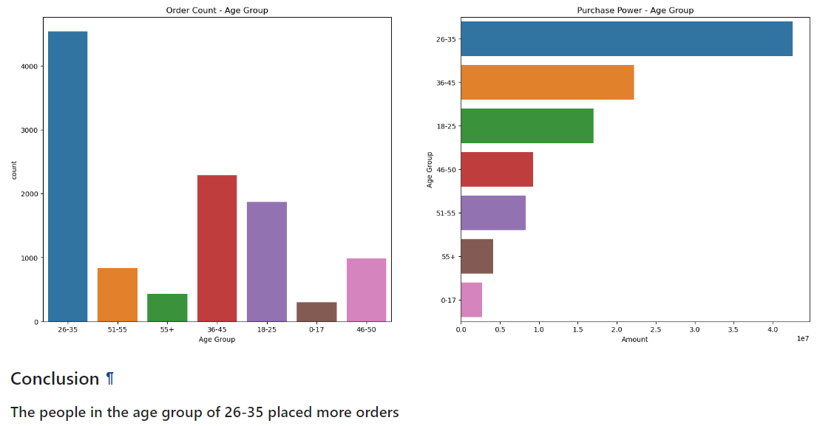
Age Group Wise Analysis

Slide 9
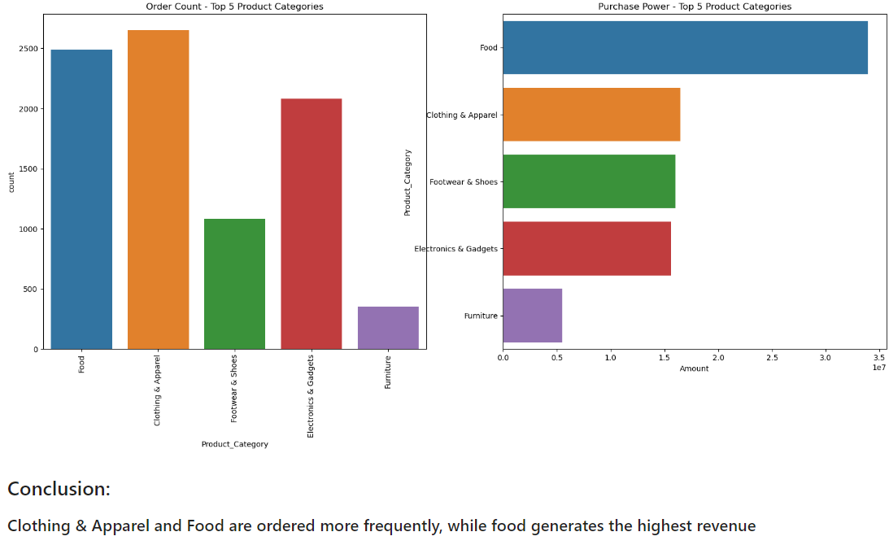
Product Category Wise Analysis

Slide 10
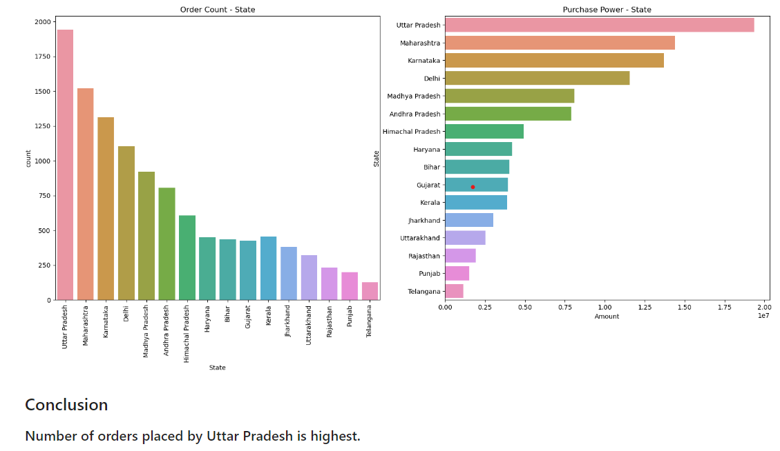
State Wise Analysis

Slide 11
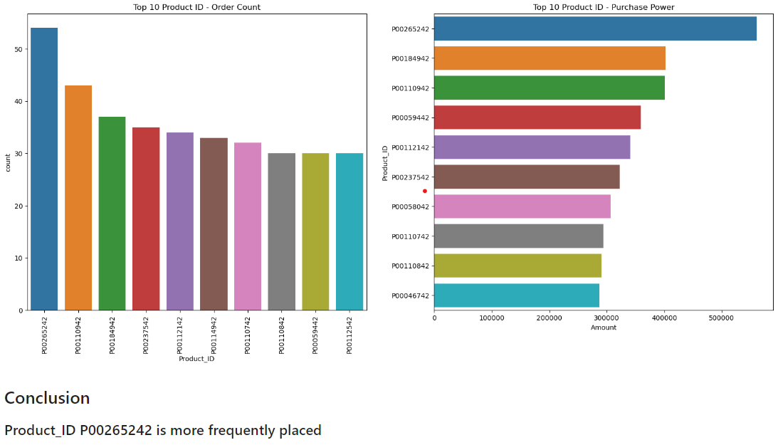
Product ID Wise Analysis

Slide 12
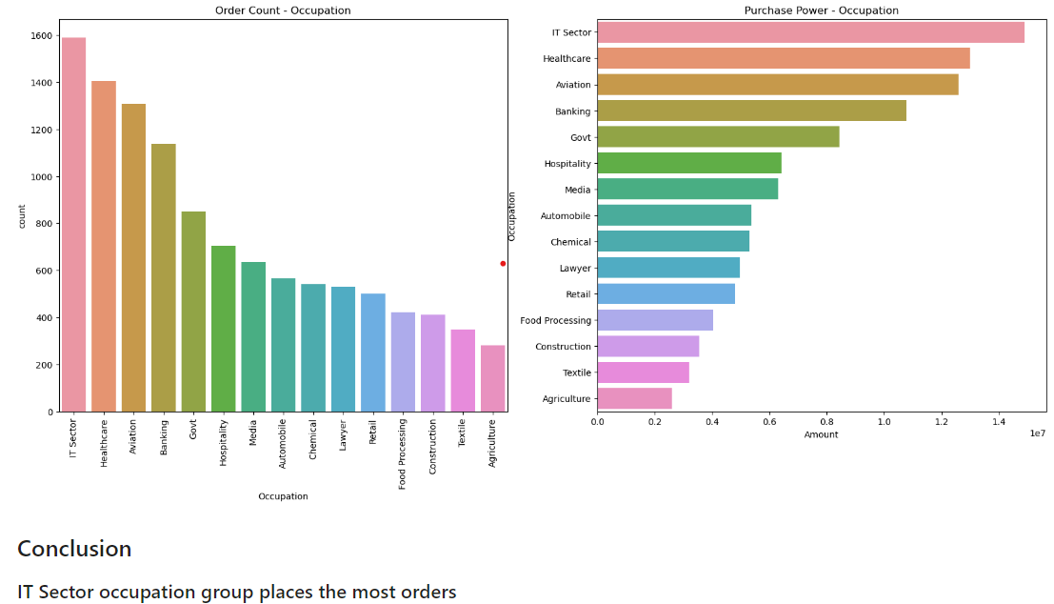
Occupation Wise Analysis

Slide 13
FINDINGS & IMPLICATIONS
Target audience to focus are people of age group 26-35 and more specifically unmarried females.
Clothing & Apparel and food are the top performers in product category
Region that is to be focused more is Uttar Pradesh as it has highest purchase power.
People from IT sector have shown highest interest in shopping from the sale by having highest purchase power among all the occupation

Slide 16
THANK YOU

